Slide 1
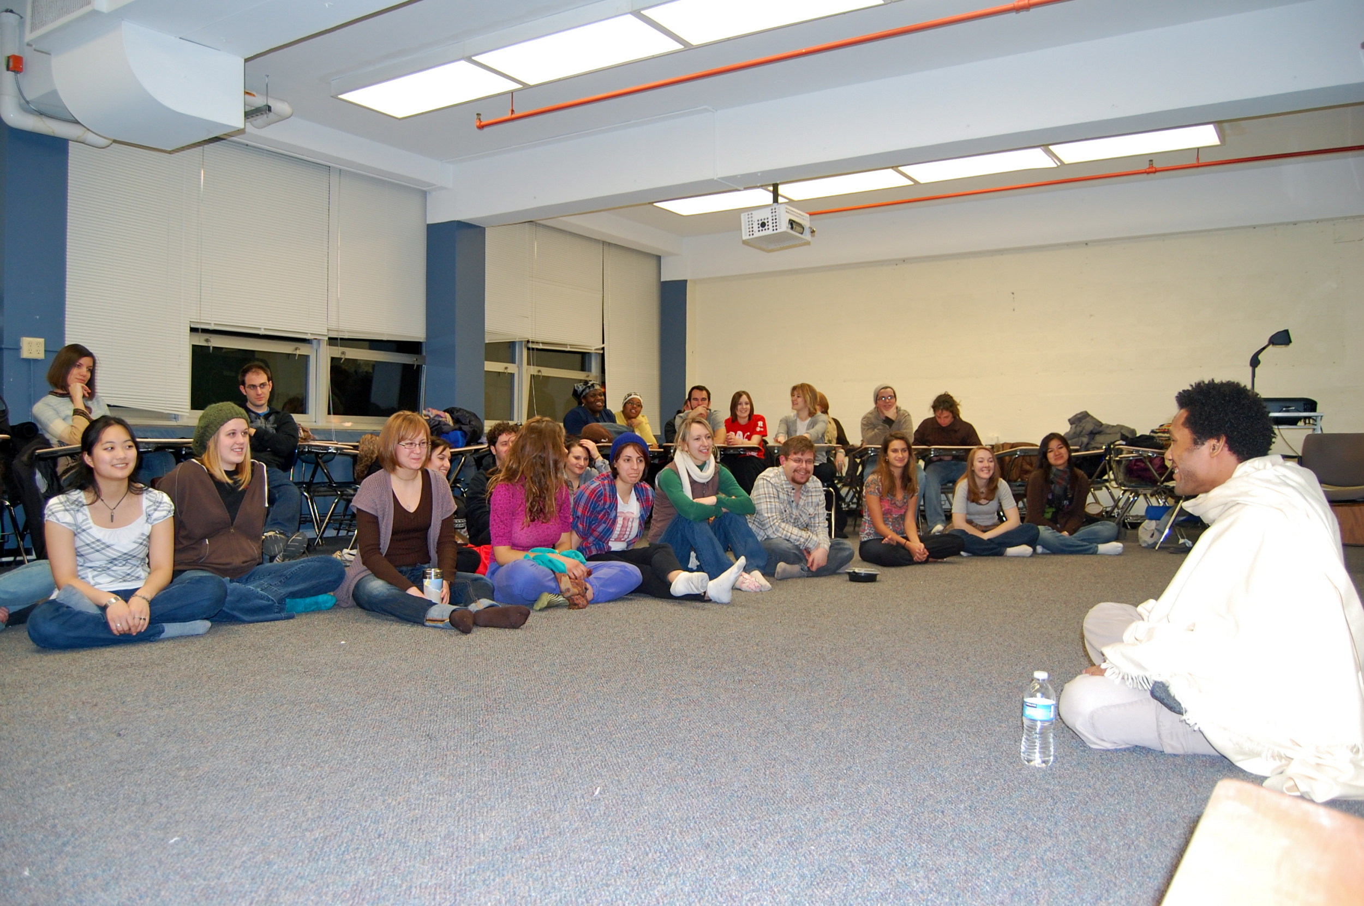
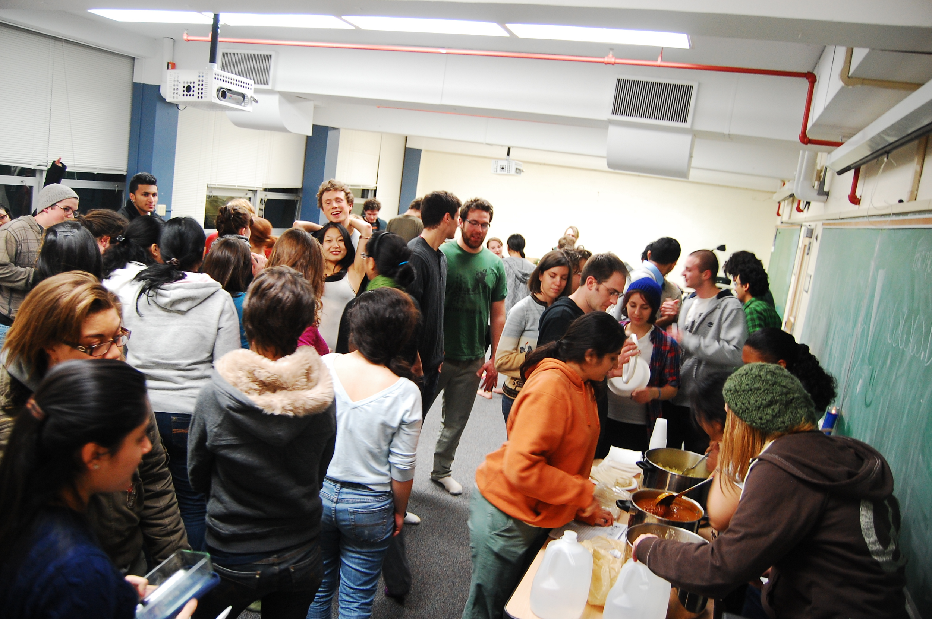
NJ

Slide 2
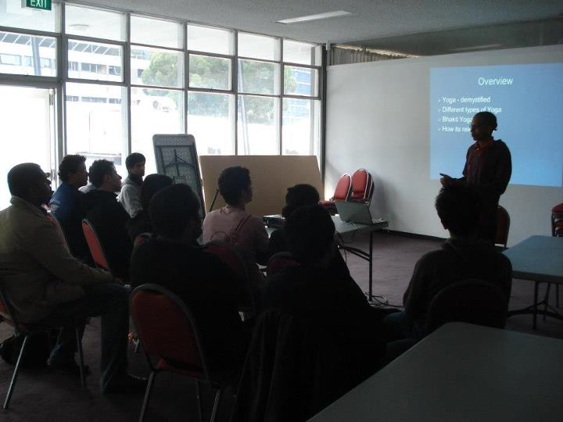
Australia UNSW

Slide 3
Activities in Bhakti Yoga class
Welcome new members ☺
Music Yoga or Kirtan (~10min)
Singing
use instruments like
Drums or Mridanga
Cymbal or Karatal
Indian keyboard or Harmonium (occasionally)
Bring your instrument
Yoga exercises (~10min)
Breathing or pranayama
Physical or asanas
Bhakti Yoga philosophy discussion (interactive) ~20min
Q & A (~10min)
Dinner snacks - yoga food (~15min)

